Slide 1
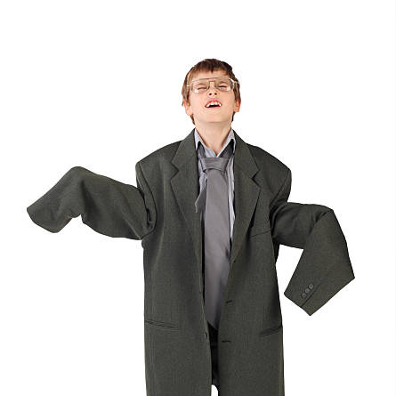
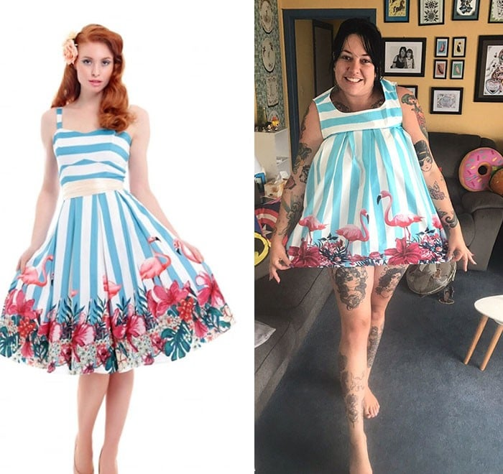

What is the biggest problem while online shopping?
CLOTHES!!!!

Slide 2

PerfectFit

Slide 3
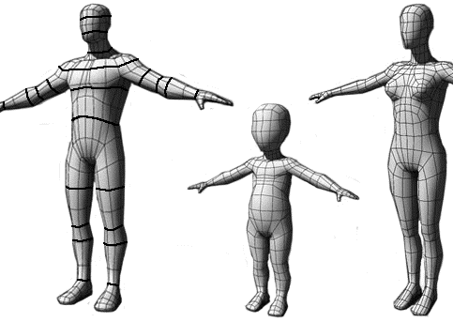
What is it?
A virtual fitting room that helps the user shop for clothes online by creating a 3d avatar using the users measurements

Slide 4

Target audience
Generation X (spend most $ online)
Gen Z and millennials (spends most time online)

Slide 5
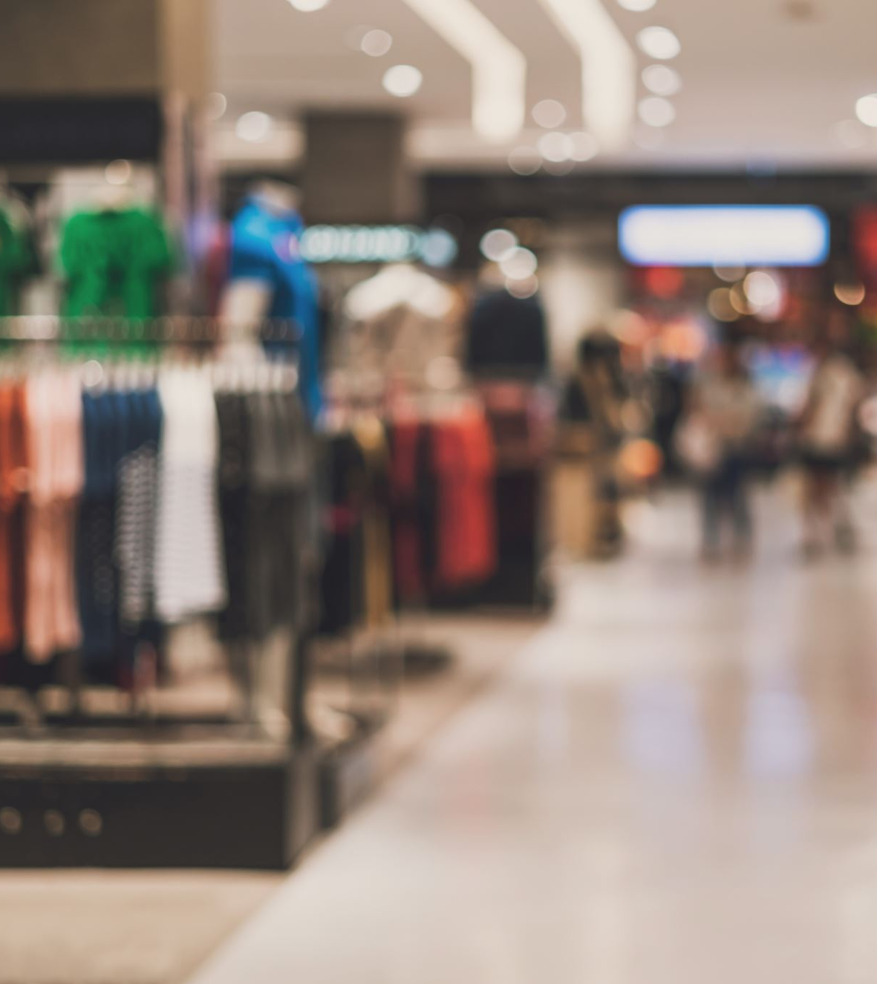
Monetization
Our goals is to make the companies pay for there clothes to be available on our app by paying a subscription fee. This way the app will be adless and free for the users

